Slide 1
Evaluating Player Relationships in Stolen Base Defense
SMT Data Challenge 2023
Jack Rogers, Kai Franke, Jackson Balch, and Isaac Blumhoefer

Slide 2

Introduction
Tracking data allows for continuous analysis during a play
One area this can be applied is stolen base defense
Many pieces of the puzzle:
Pitcher holding and location
Catcher receiving and throwing
Fielder tagging
Example:
Catcher and pitcher do their job
However, the fielder fails to make the out
Notes:
Caught stealing puts all blame on catcher, can describe relationship
Importance of having tracking data:
Baseball is analyzed discretely/outcome based
We want to understand the process of how an outcome is created
Stolen base example
We usually analyze stolen base defense by SB%
However, there’s many pieces of this puzzle
Talk about play

Slide 3
How can we measure individual contributions in stolen base defense?
Derive useful information from tracking data
Build an hierarchical model to predict the success of a stolen base at different stages
Evaluate each player’s contribution
Notes:
How can we actually do this?
With the tracking data we had, we were able to to get information about the locations of all the players involved, along with the ball, so we created useful information with all of it
We built models at different stages of the stolen base to understand how each relate to every position
Then used those to understand how each player led to different parts of the stolen base attempt

Slide 4
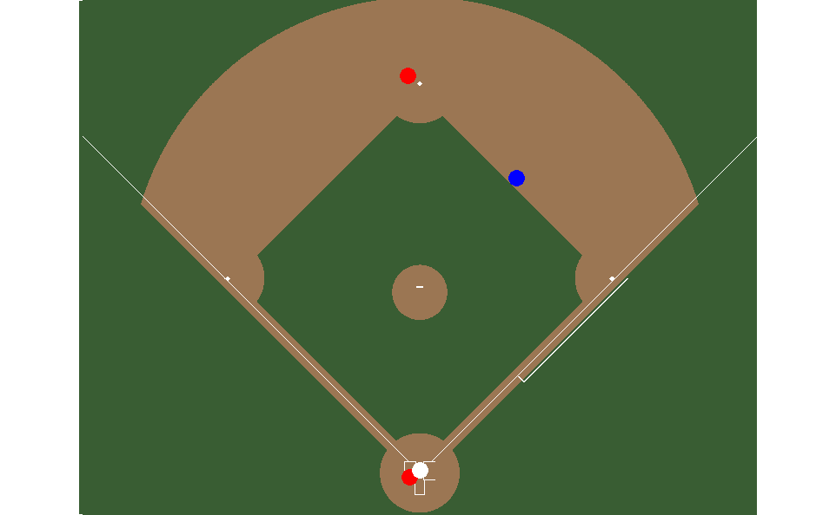
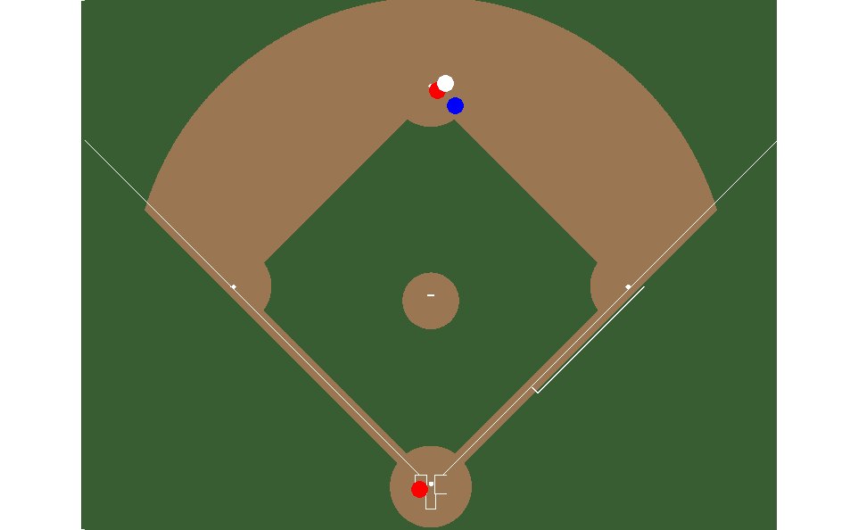
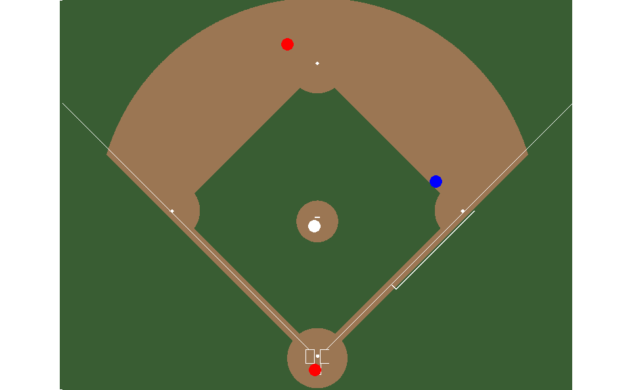
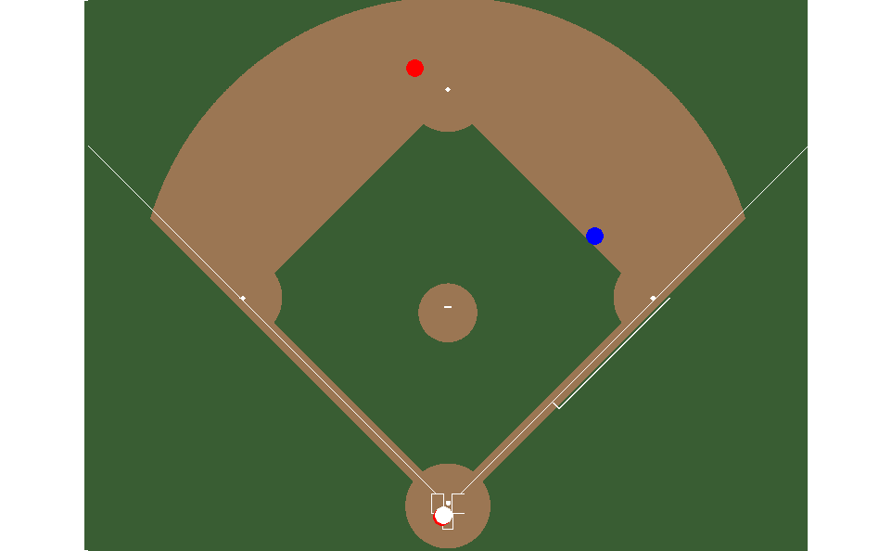
Four Unique Stages
Break a play up into four stages and their unique inputs:
Pre-Play: Build a Base Prediction for the Runner
Sprint Speed on Play, Independent of Fielder Performance
Pitch: Analyze Pitchers Impact on Play
Speed, Jump, Pitch Location
Catch: Analyze Catcher Footwork/Exchange
Above with the addition of exchange
Throw: Analyze Catcher’s Throw and Fielder’s Tag
Above with the addition of the Catcher’s throw (Speed and Location)
Notes:
Each stage works and build upon the last one
Use unique features to the stage that are added on
Look at how probabilities change as we move stage to stage and attribute that to each player

Slide 5
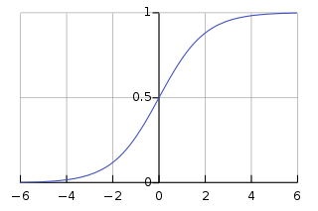
Modeling
Probabilities, not just outcomes
Staged process allows us to find individual impact at each point
Emphasize Interpretability
LASSO Logistic Regression
Tree-Based Methods Overfit
LASSO allows us to do feature selection easily
Utilize leave one out cross validation to combat small sample size
Notes:
Small sample size so tree-based models overfitted, low accuracy in prediction
Wanted to go simple for sake of interpretability as well
Able to give us the benefits of prediction of success, and then we can attribute the change between stages as change in prediction via the input

Slide 6
Results
Pre-Pitch: 0.57
Evaluated models using Log Loss and probabilistic bucketing
Models outperformed baseline accuracy metrics
Model gets more accurate as play progresses
Ensure model coefficients made intuitive sense
Able to extract interpretable impact at each stage
Post-Pitch: 0.69
Exchange: 0.67
Throw/Tag: 0.55
Model Log Loss by Stage
Notes:
Make sure to talk more in depth about graphic

Slide 7
Example
Inputs:
Runner Speed: 28.6 Ft/Sec
Probability of Successful Steal: 0.6
Inputs:
Low Pitch, Time To Plate .5 S
Probability of Successful Steal: 0.567
Pitcher:
0.6 - 0.567 = 0.033 Outs
Inputs:
Exchange: 0.8 Seconds
Probability of Successful Steal: 0.578
Catcher: 0.567 - 0.578 = -0.011 Outs
Inputs:
Throw: Low, Accurate, 1.2 s
Probability of Successful Steal: 0.114
Catcher:
0.574 - 0.114 = 0.464 Outs
Player is called out:
Probability of Successful Steal: 0
Fielder: 0.114 - 0 = 0.114 Outs

Slide 8
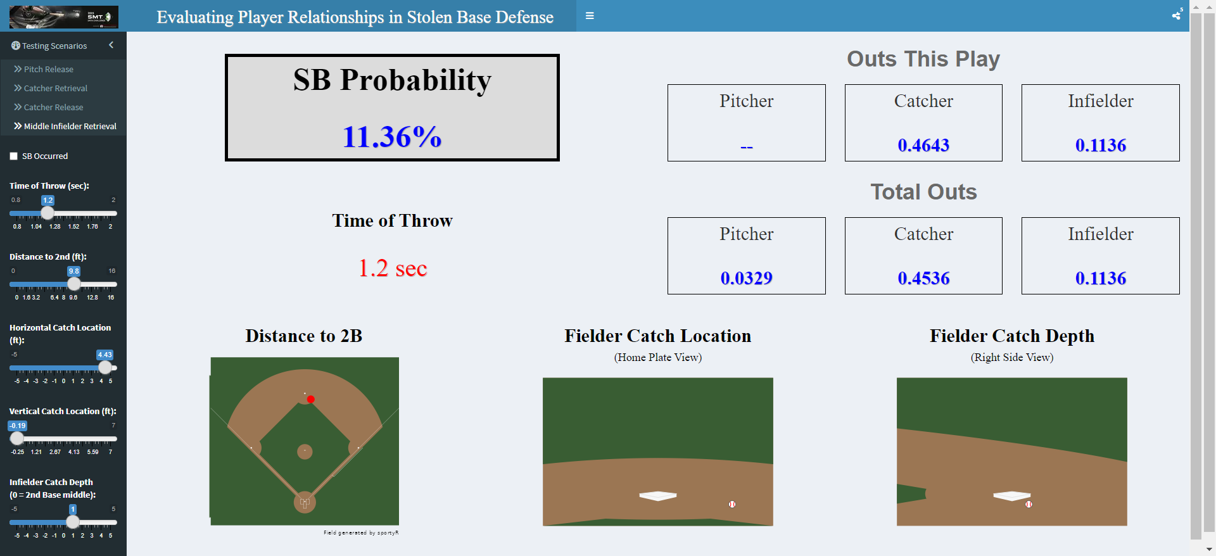
Shiny App
Player development information
Animations for visualizing plays
Benefits:
Accessibility/Interpretability
Interactive game situations
Shiny App
Notes:
Move things over

Slide 9
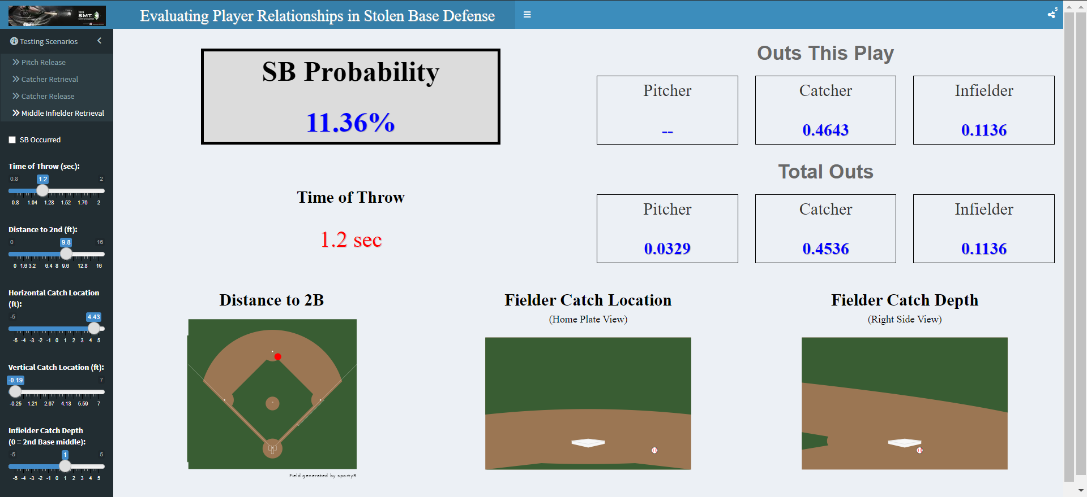

Shiny Example

Slide 10
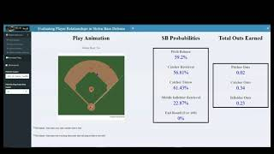
Play Animations

Slide 11

Questions?
Link for Shiny App, Github, LinkedIns
Notes:
Comment for Access shiny app, github, linkedins

